Slide 1
Your Personal Performance & Development Review Guide June 2021
Delivering local healthcare you can trust

Slide 2
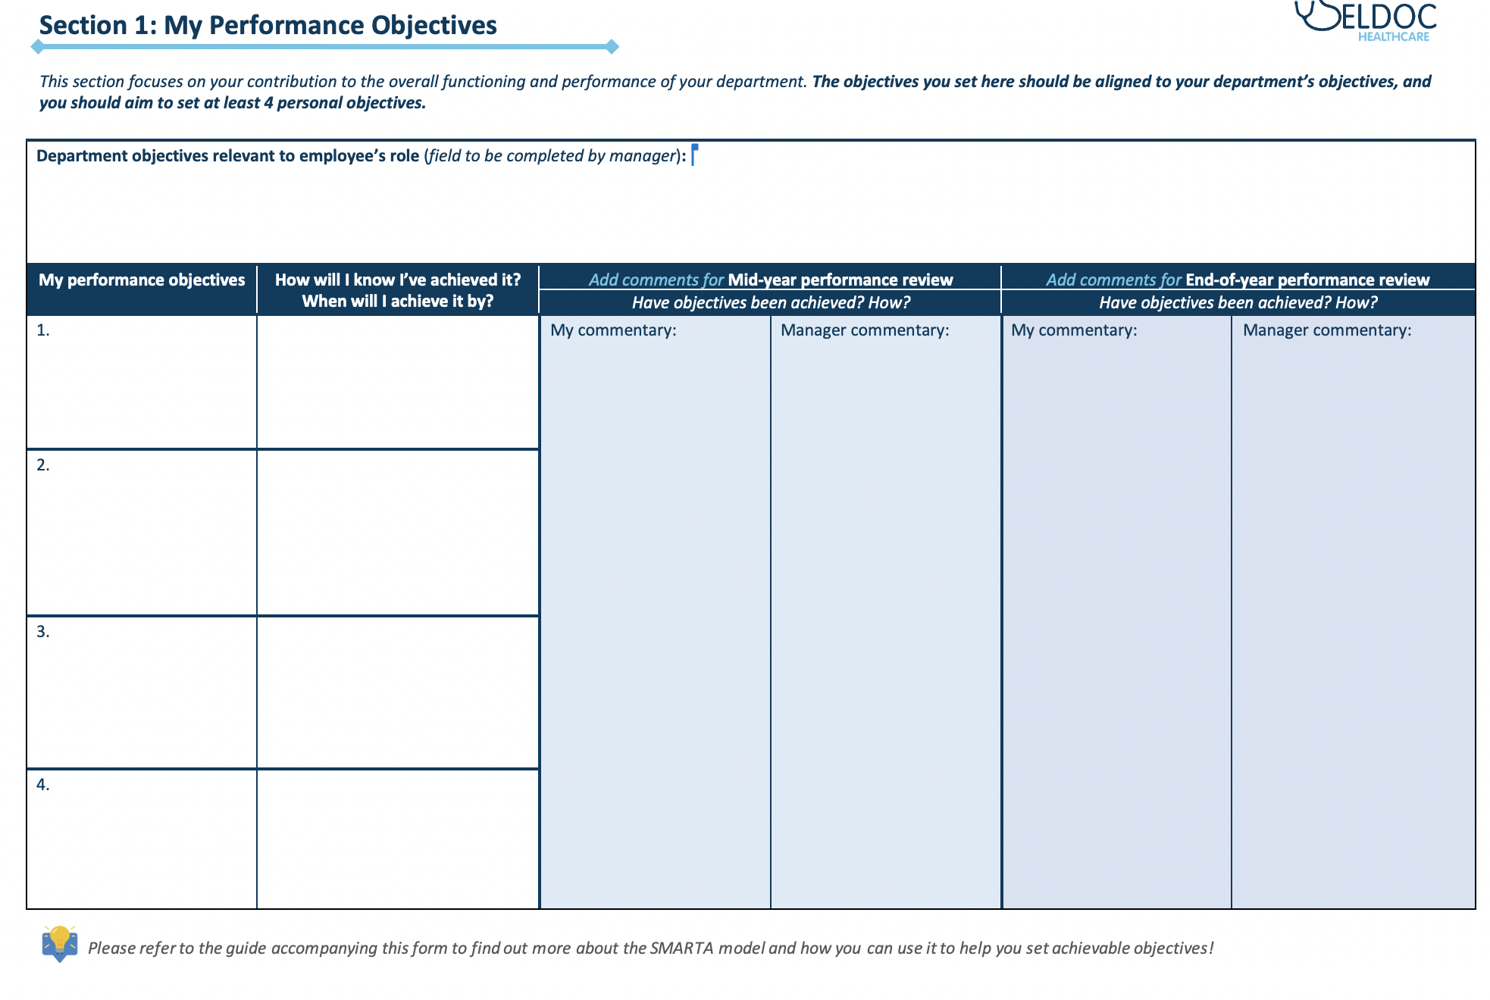
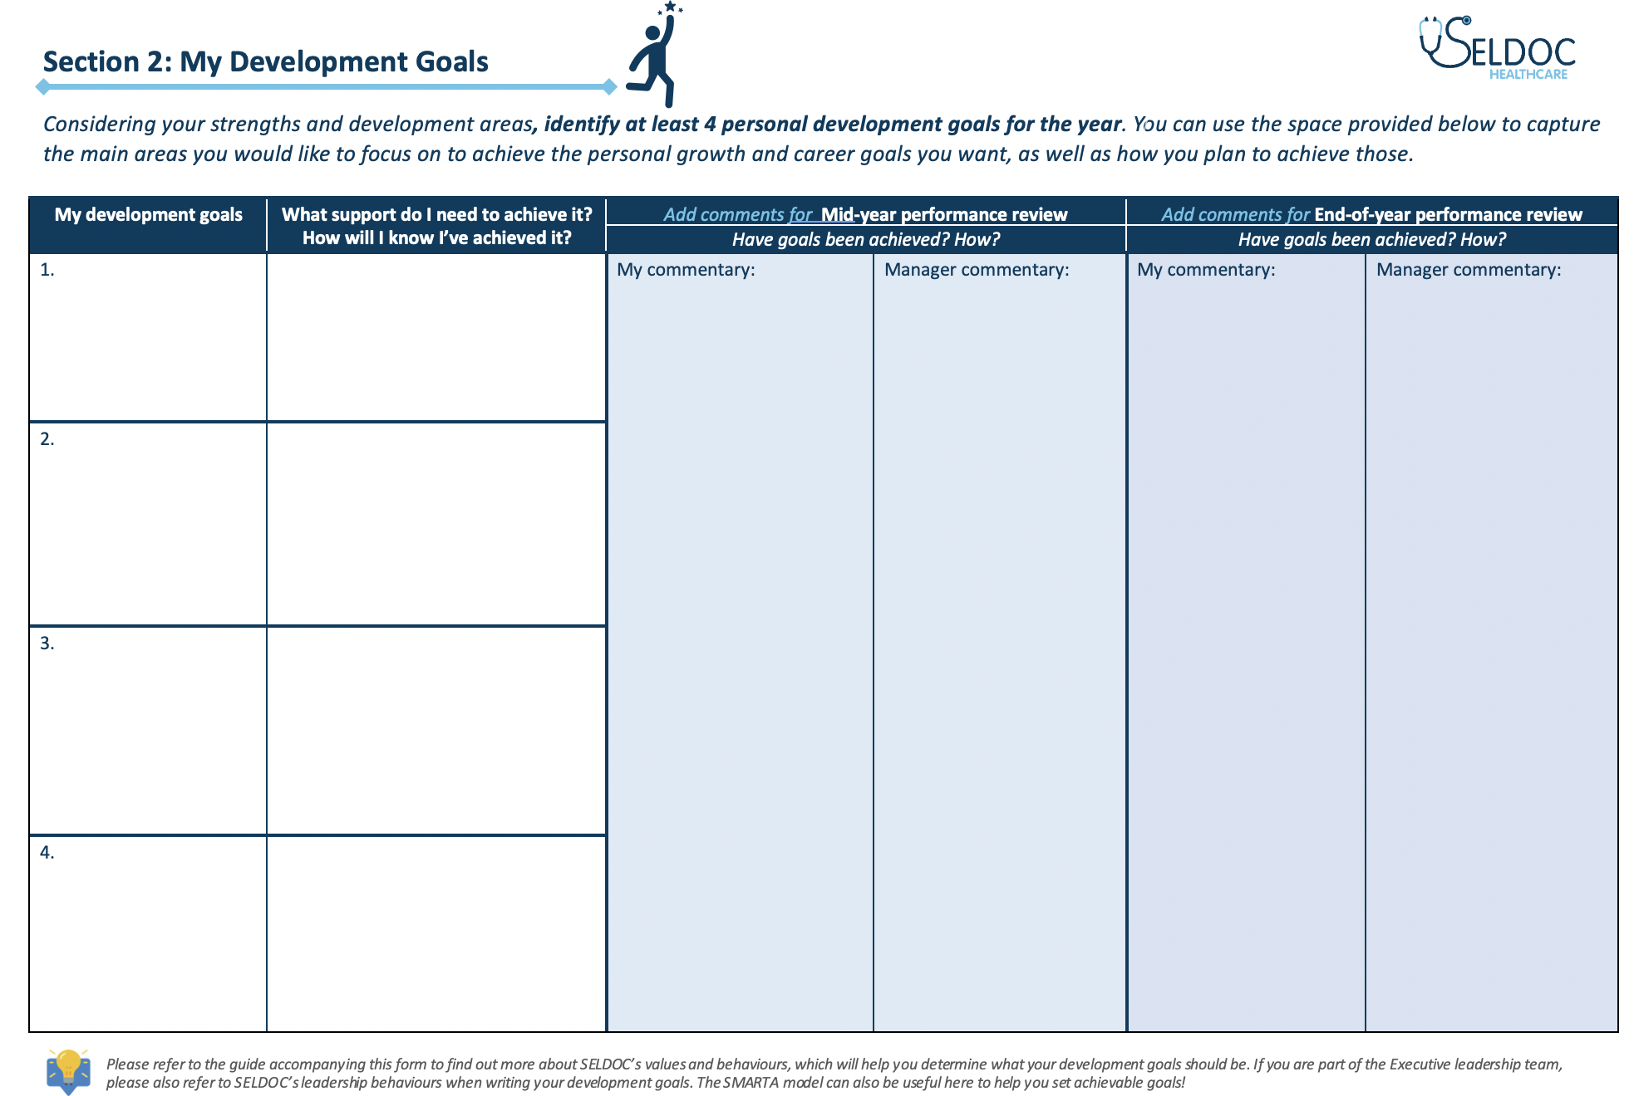
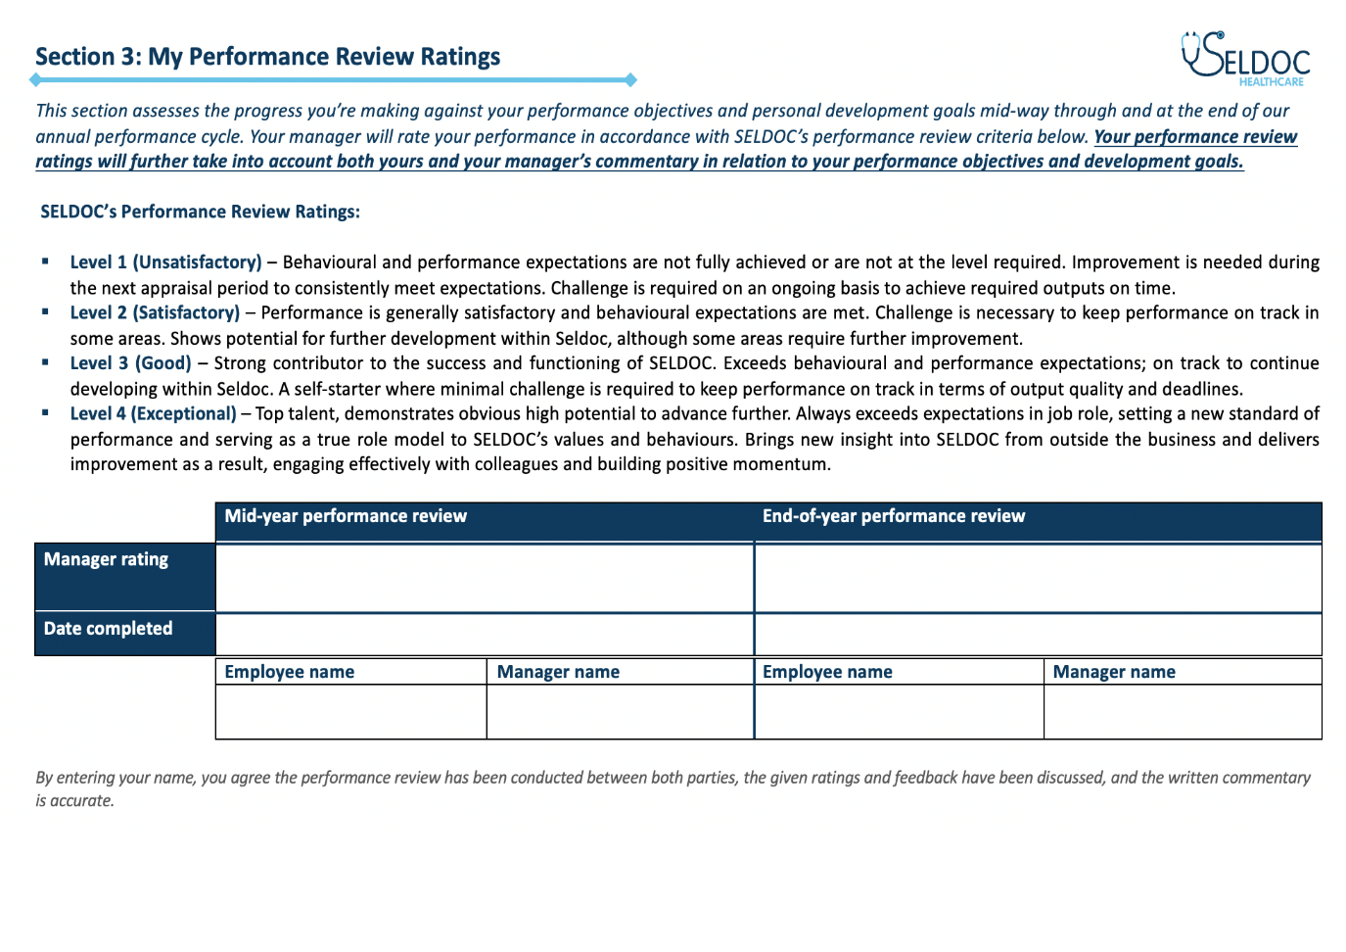
How to complete your personal performance & development review form
This guide will help you complete your personal performance & development review form, as well as help steer your performance conversations. With support from your manager, you should use the form to set your objectives, create a plan for your personal development, and document your performance review ratings. The form consist of three main sections:
Sections 1 & 2: My Performance Objectives & My Development Goals should be completed at the beginning of the year and can be updated regularly throughout. The final 4 columns of the table in each section are for your mid- and end-year performance review commentary and should be completed only when you’ve reached that stage of the annual appraisal cycle.
Section 3: My Performance Review Ratings should be completed as part of your end- and mid-year performance review.

Slide 3
Contents
The annual performance cycle explained
SELDOC’s core values and why they are important
Section 1: My Performance Objectives
Section 2: My Development Goals
Section 3: My Performance Review Ratings
Monthly Catch-ups and One-to-ones Form
Appendix: Our Leadership Promise (Executive team members only)

Slide 4
The annual performance review process explained
Year start (April – May)
Objective setting
Development planning
The annual performance review process runs from April to March each year.
At the beginning of each year, your manager will help you set you performance objectives and personal development goals. Your progress against those will be reviewed twice – towards the middle and end of the year.
You should aim to at least one monthly one-to-one catch up with your manager to ensure you are on track to meet your objectives and receive regular feedback about your performance and development.
During the year
(June – August)
Year end (February – March)
End-of-year performance review
One-to-one catch ups
Regular feedback
Mid-year
(September – October)
During the year
(November – January)
One-to-one catch ups
Regular feedback
Mid-year performance review

Slide 5
SELDOC’s core values and why they are important
The SELDOC core values define who we are as a business, how we operate with patients, clients, and each other - how we come together as a team. As such, our values are critical to preserving our business ethos and integrity and providing everyone with a common understanding of what working at Seldoc is all about.
On the next page, you’ll see how each one of SELDOC’s 5 core values is supported by a set of behaviours. These behaviours describe what is collectively expected from us as a team and apply to everyone working at SELDOC.
The ‘WHAT’ & ‘HOW’ of setting your performance objectives and development goals
When writing your performance objectives and development goals, you should always address the ‘WHAT’ & the ‘HOW’. The ‘WHAT’ specifies what your objective/goals is, while the ‘HOW’ refers to how you plan on achieving those. SELDOC’s core values and behaviours should always guide ‘HOW’ you set out to achieve your objectives/goals. Your manager will provide you with regular developmental feedback on how you are performing against both the ‘WHAT’ & the ‘HOW’ aspects, and your performance review ratings will also take these into account.
Executive Leadership Team Members only:
As SELDOC’S leadership team, you have the crucial responsibility to set a standard of performance and behaviour for the rest of SELDOC. Please ensure you consider SELDOC’s leadership behaviours (see appendix of this guide) when setting your objectives and development goals, as you will also be expected to uphold and perform against these.

Slide 6
SELDOC’s values
And how everyone should uphold our core values…
Patients-First
We work together to provide exceptional care which local communities can trust.
We prioritise our patients’ needs over everything else.
We treat and care for our patients the way we would want to be treated and cared for.
Compassionate
We respond to those who need our help with kindness and empathy.
We value diversity and treat everyone with respect.
We listen to others and ensure every individual has the opportunity to be heard.
Competent
We achieve the highest quality service through outstanding clinical and operational expertise.
We take responsibility for our actions and hold each other to account.
We deliver safe and reliable care.
Empowering
We empower people to make the right choices by keeping them informed.
We provide our people with the tools they need to be brilliant at their jobs.
We work hard to learn from and build on our successes.
Adaptable
We embrace innovation and adopt new technologies to provide better care for our patients.
We are committed to developing long-term partnerships that benefit the quality of our care.
We remain dependable during times of change or disruption.

Slide 7
Section 1: My Performance Objectives
Setting your performance objectives for the year is important because it will help you to better understand what is expected of you in your role and what activities you will need to complete in order to be successful in it. However, it is important to note that your objectives should go beyond your basic role expectations and demonstrate your personal contribution to the overall functioning and performance of your department.
When entering your objectives in your form, ensure you specify what the objective is, how you plan to achieve it, and when you plan to complete it by. The final 4 columns of the table in this section should be completed only when you’ve reached your mid- or end-of-year review.
Helpful tip: A good strategy to use when writing your objectives is the SMARTA model.
Specific – Write clear and concrete objectives
Measurable – Ensure your objectives can be measured
Achievable – Set only realistic objectives
Relevant – Set objectives relevant to your role
Time-bound – Decide when you will complete your objectives by
Aligned – Ensure your objectives are aligned to the overall business priorities

Slide 8
Section 2: My Development Goals
Your development goals represent an important aspect of your journey at SELDOC. Setting the right goals will enable you to receive training and development aligned to your overall career aspirations, as well as help us ensure that you are adequately equipped to fulfil your role responsibilities.
You can use the space provided in the form to record any goals you’d like to focus on throughout the year. You can discuss and agree those with your manager to ensure you set the right goals for you and your development at SELDOC. The final 4 columns of the table in this section should be completed only when you’ve reached your mid- or end-of-year review.
Helpful tip: When discussing your development goals with your
manager, you can use the following pointers to guide your conversation:
What are your current strengths?
What are some areas you’d like to work on?
What are your future goals for your career at SELDOC and beyond?
Which of SELDOC’s values and behaviours are key to your role and what can you do to ensure you consistently uphold these?
How do you need to develop to achieve your performance objectives?
How do you need to develop to achieve your career aspirations?

Slide 9
Section 3: My Performance Review Ratings
Your manager will have to formally review your performance and overall contributions to the success of SELDOC towards the middle and end of the year. As part of this process, you will receive a performance rating which will objectively measure progress against your performance objectives, your ability to uphold and live by SELDOC’S values, and the extent to which you achieved your development goals.
Your performance rating will be recorded in Section 3 of the form. You can find out what SELDOC’s performance ratings are and what they mean on the next page of this guidance pack.
Please note: Your performance review ratings will have taken into account both yours and your manager’s commentary in relation to your performance objectives and development goals. As part of your discussion, it is also important to address the ‘WHAT’ and the ‘HOW’:
Has the objective been achieved? – Comments in this section should reflect on your general performance against objectives and progress on personal goals.
How has the objective been achieved? – Comments should reflect your behaviours and whether you managed to achieve your objectives/goals by upholding SELDOC’s core values and behaviours.

Slide 10
SELDOC’s Performance Review Rating Scale
Level 1 (Unsatisfactory) – Behavioural and performance expectations are not fully achieved or are not at the level required. Improvement is needed during the next appraisal period to consistently meet expectations. Challenge is required on an ongoing basis to achieve required outputs on time.
Level 2 (Satisfactory) – Performance is generally satisfactory and behavioural expectations are met. Challenge is necessary to keep performance on track in some areas. Shows potential for further development within Seldoc, although some areas require further improvement.
Level 3 (Good) – Strong contributor to the success and functioning of SELDOC. Exceeds behavioural and performance expectations in a number of areas; on track to continue developing within Seldoc. A self-starter where minimal challenge is required to keep performance on track in terms of output quality and deadlines.
Level 4 (Exceptional) – Top talent, demonstrates obvious high potential to advance further. Always exceeds expectations in job role, setting a new standard of performance and serving as a true role model to SELDOC’s values and behaviours. Brings new insight into SELDOC from outside the business and delivers improvement as a result, engaging effectively with colleagues and building positive momentum.

Slide 11
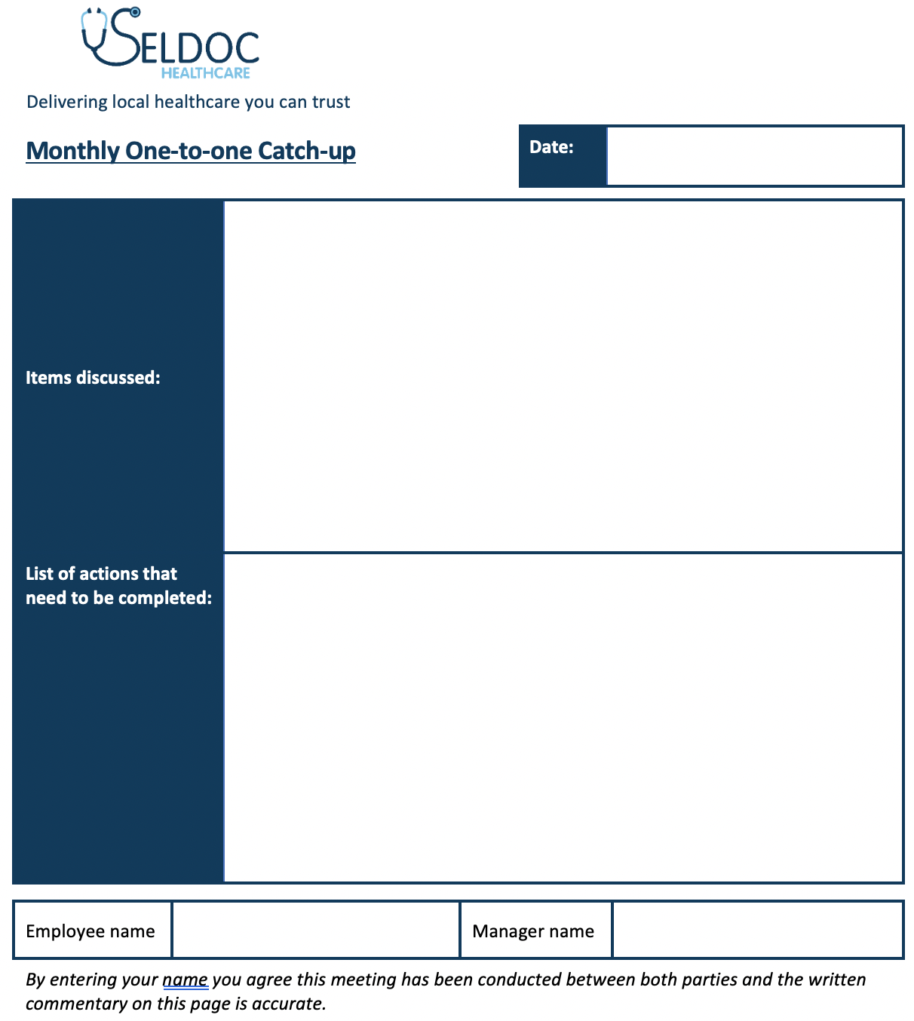
Catch-Ups and One-to-Ones Form (making notes from one to ones is required)
You should aim to have at least one monthly catch-up scheduled with your manager to discuss your progress against objectives, other areas where you may need support or value a conversation, and receive developmental feedback. These meetings must be documented and we recommend this easy format to capture notes.

Slide 12
Appendix: Our Leadership Promise (Executive Leadership Team Members only)
Patients-First
I perform my role in accordance with the highest professional standards.
I support my colleagues in delivering excellent healthcare.
I regularly communicate with my colleagues to ensure we are aligned on processes and dependencies.
Compassionate
I am understanding of and responsive to my colleagues’ needs.
I demonstrate to my colleagues that I value their contribution and input.
I treat my colleagues with respect and kindness at all times.
Competent
I make things happen in a timely manner and always complete what I started.
I take ownership and accountability for my decisions and actions.
I am honest about my strengths and weaknesses and ask for help when I need it.
Empowering
I collaborate with colleagues to achieve collective outcomes.
I provide honest feedback to help my colleagues reach their full potential.
I challenge and support my colleagues to ensure we deliver the best possible outcomes.
Adaptable
I am creative in my approach and bring bold, brave ideas to the table.
I think strategically and take initiative to identify solutions not problems.
I am committed to promoting the business both internally and externally.

